Slide 1


Predicting House Prices in Abuja Using Machine Learning
DEPARTMENT OF COMPUTER ENGINEERING
FACULTY OF ENGINEERING
AHMADU BELLO UNIVERSITY, ZARIA
Umar Umar Sani
(P25EGCP8057)
COEN807 (Machine Learning) Term Project Dept. Of Computer Engineering, ABU, Zaria
2026

Slide 2
Problem Overview
Challenge: Manual property: valuation is subjective & inconsistent
Goal : Build reproducible ML pipeline for price prediction
Importance: Supports buyers, sellers, regulators

Slide 3
Dataset Description
Source: Kaggle / Open Data (Nigeria Real Estate)
Records: ~5,000 properties
Features: Floor area, bedrooms, bathrooms, location, year built
Target: Price (millions NGN)
Diagram: Table snapshot of dataset

Slide 4
Data Preprocessing
Handle missing values (median imputation)
Encode categorical variables (One-Hot for location)
Linear programming's effectiveness in improving scheduling efficiency and reducing costs
Normalize continuous features (MinMax scaling)
Feature engineering: Price per sqm, property age
Diagram: Flowchart of preprocessing pipeline

Slide 5
Methodology
Models compared:
Linear Regression (baseline, interpretable)
Polynomial Regression (captures non-linear trends)
Random Forest (robust, complex interactions)Ensure shifts are covered by qualified staff
Diagram: Model comparison schematic

Slide 6
Experiment Setup
Split: 70% train, 15% validation, 15% test
Metrics: MAE, RMSE, R²
Hyperparameter tuning: GridSearchCV for Random Forest
Diagram: Train/Validation/Test split illustration

Slide 7
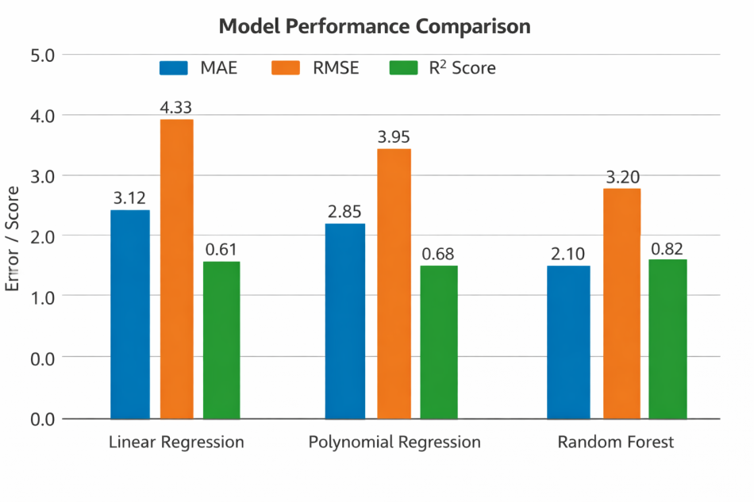
Results
Model Performance Comparison Table
Model | MAE | RMSE | R2
Linear Regression | 3.12 | 4.33 | 0.61
Polynomial Regression | 2.85 | 3.95 | 0.68
Random Forest | 2.10 | 3.20 | 0.82

Slide 8
Residual Analysis
Linear Regression: Residuals show parabolic pattern → underfit
Polynomial Regression: Better fit, reduced curvature
Random Forest: Residuals closer to random scatter
Diagram: Residual plots (Linear vs Polynomial vs RF)

Slide 9
Comparative Analysis
Linear Regression: Simple, interpretable, weaker accuracy
Polynomial Regression: Better fit, risk of overfitting
Random Forest: Best accuracy, less interpretable
Trade-off: Accuracy vs Interpretability

Slide 10
Key Findings
Random Forest achieves lowest error (best predictive power)
Linear Regression remains defensible for regulatory contexts
Polynomial regression improves fit but adds complexity

Slide 11
Challenges & Lessons Learned
Dataset limited to Abuja → risk of distribution shift
Location encoding may proxy socio-economic bias
Lesson: Balance predictive power with fairness & transparency

Slide 12
Conclusion
ML can improve property valuation accuracy
Random Forest recommended for predictive tasks
Linear Regression recommended for interpretability in disputes
Future work: Expand dataset, fairness-aware ML, SHAP interpretability

Slide 13
Future Work
Larger dataset across Nigerian states
Incorporate socioeconomic fairness checks
Deploy explainable AI tools (e.g., SHAP, LIME)
Continuous monitoring post-deployment

Slide 14
GitHub & Artifacts
GitHub repo: Source code, notebooks, README
Artifacts: Trained models, residual plots, evaluation tables
Reproducibility: Clear workflow, dependencies listed

Slide 15
Closing
Thank you

